Slide 1
PlaceMentor

Slide 2
Project Guide
I. Pavan Kumar
Assistant Professor
VNRVJIET
Team Members
Anurag Pola 18071A1264
Arpan Jain .18071A1266

Slide 3
Abstract
Every college desires to see their students settled in their career, the first phase of which is them getting a good placement. Placements also reflect the standards of the college. Hence placements are a key element to both college and students. But today, many colleges are using some sort of messaging platform such as WhatsApp, Telegram so as to establish communication between students and Training & Placement Cell on placement related activities. This also consists of a lot of manual work and is tedious. Negligence on even a small thing from either party would result in great loss. A better solution is needed to address the issues faced by both college and students in the context of placements.

Slide 4
Problem Statement
Building a platform which enables students to seamlessly access placement related information while on the other side Training & Placement cell can get an easy way to both monitor students and provide information about the same.

Slide 5
Current Solutions
WhatsApp groups (Our College)
Google classrooms (NIT Hamirpura)
Web Portals (IIT Kanpur)

Slide 6
Problems with current Solutions
No proper communication between students and T&P department
Partial/Incorrect information regarding placement drives
Missing deadlines of opportunities, both on-campus and off-campus
Improper tracking of students’ progress from T&P and students themselves
No proper guidance to prepare for placements
Inefficient feedback system

Slide 7


Proposed Solution
App
Website

Slide 8
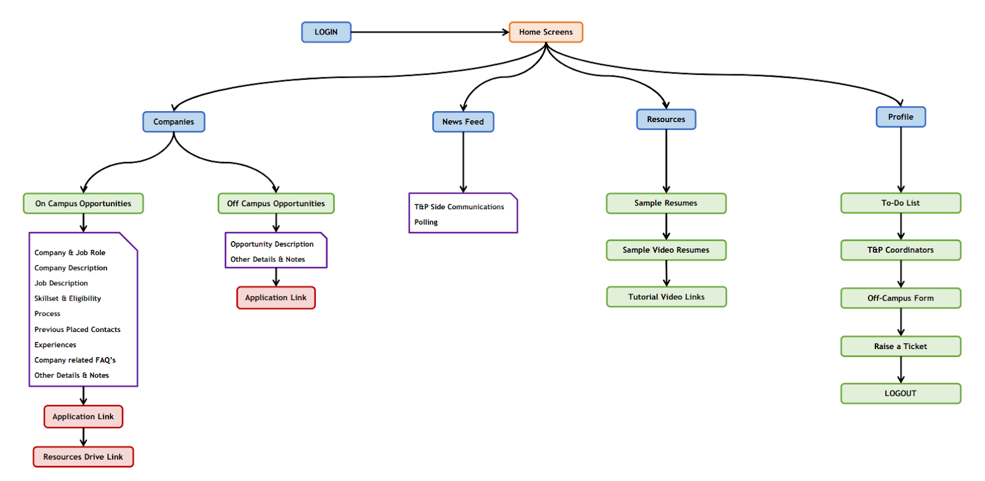
Workflow

Slide 9
REQUIREMENTS
Design Tools : Figma
Frameworks : Flutter, Dart, Firebase
Software Requirements : Android Studio, VS code
Knowledge on Mobile Application and Web Development

Slide 10
Expected Outcome
App:
A mobile application which would help students to access all the information from T&P Cell and also enables two way communication
Website:
A website through which T&P can push data to the mobile application and also communicate with students about their queries.

Slide 11





| Designs |

Slide 12

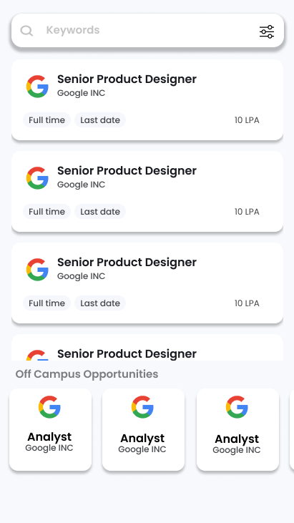
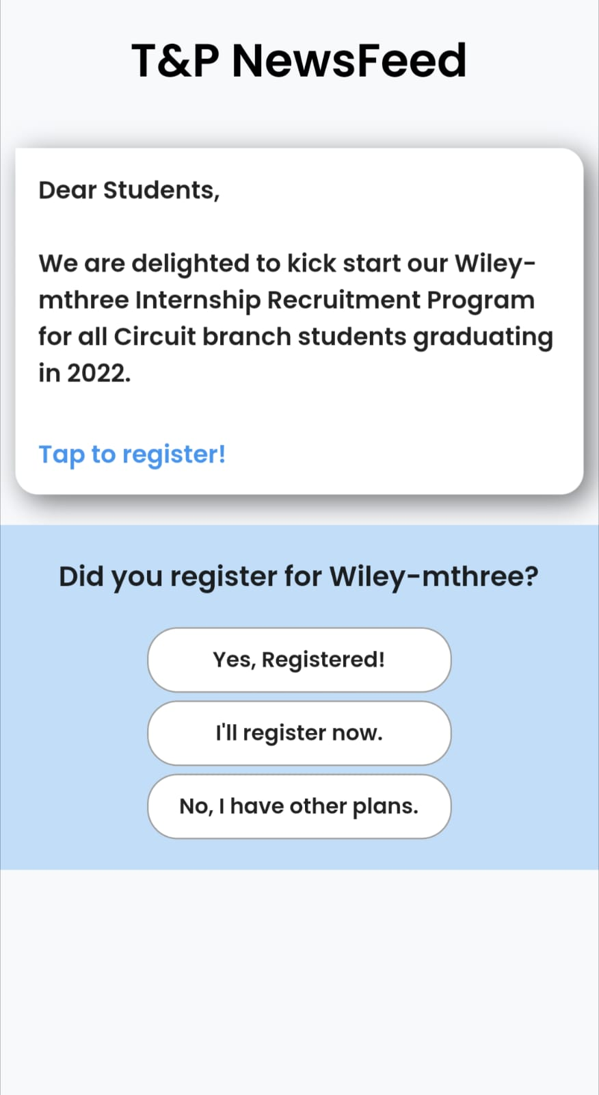
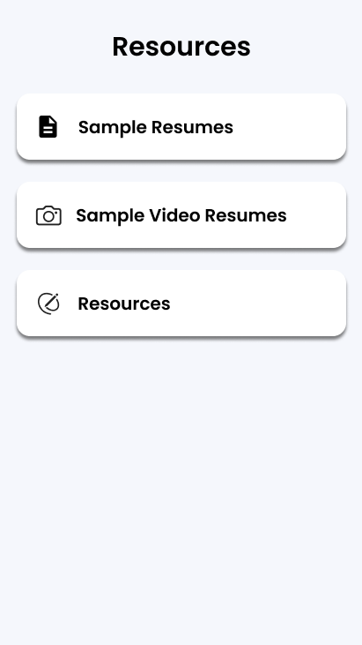
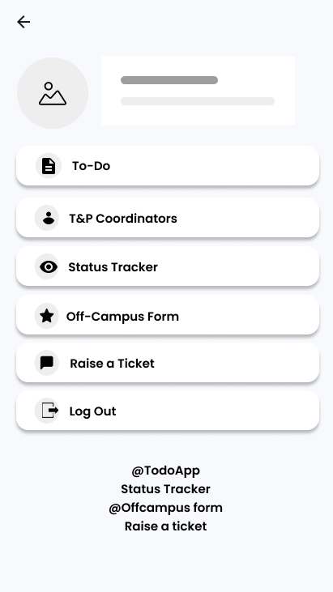

Slide 13
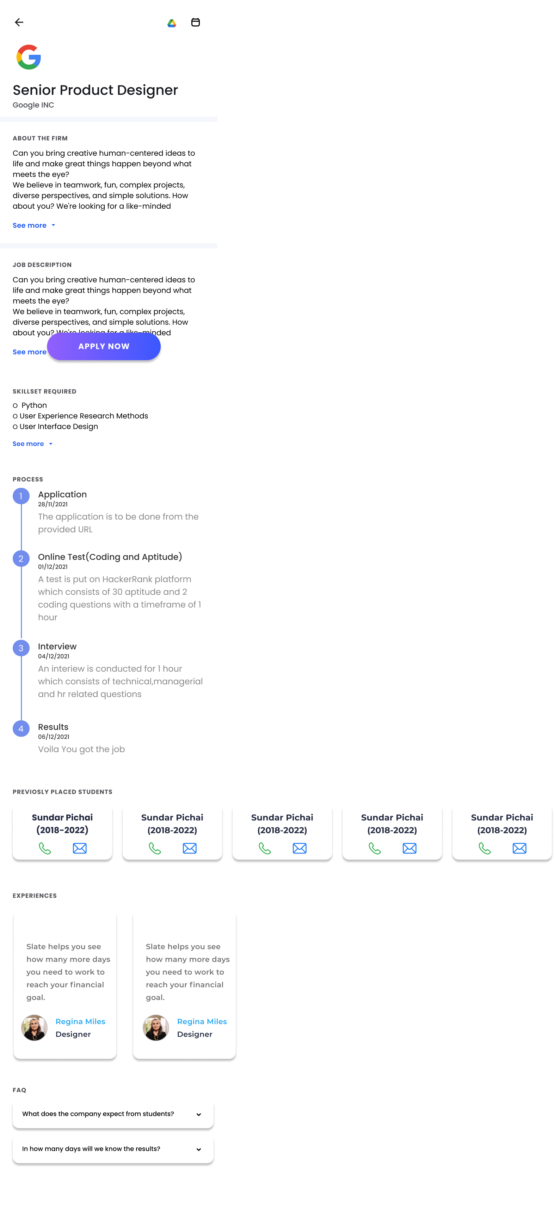
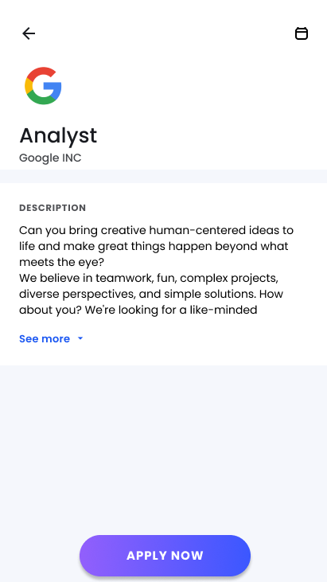

Slide 14
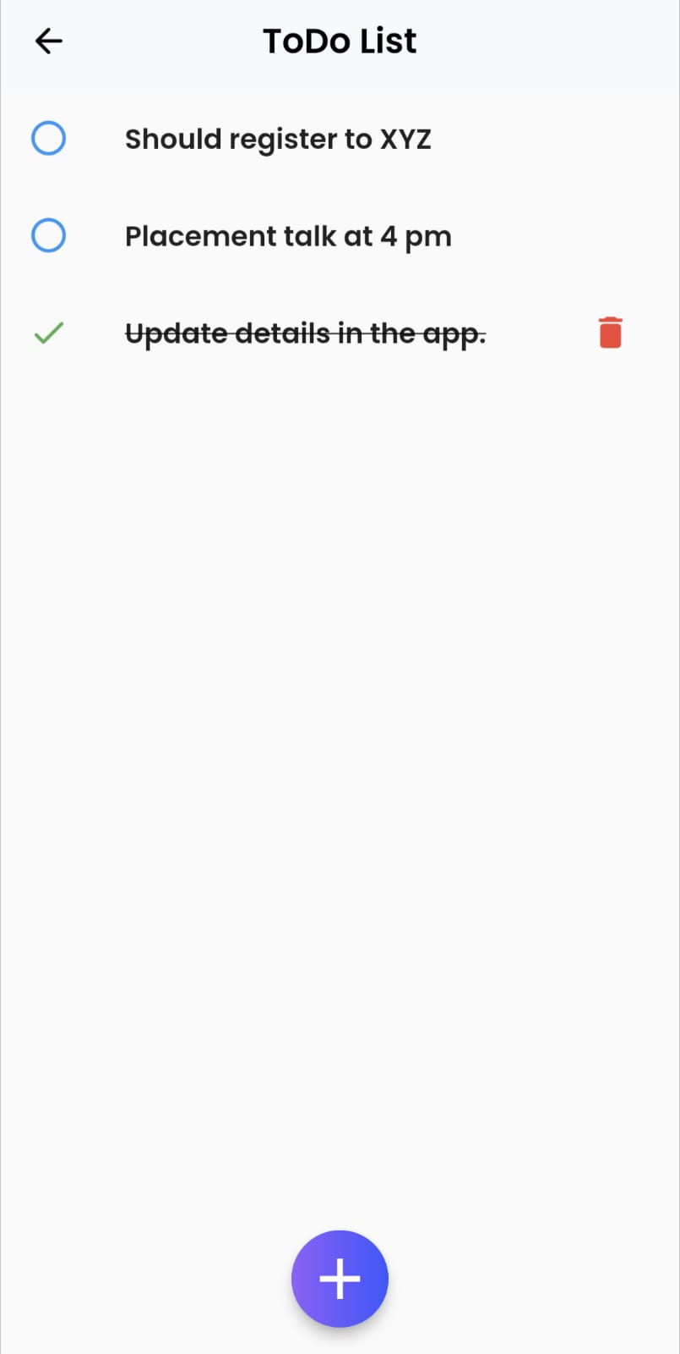
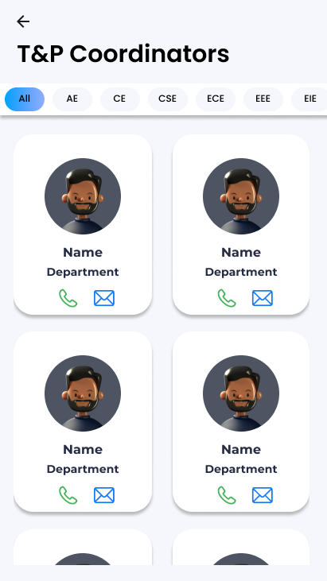
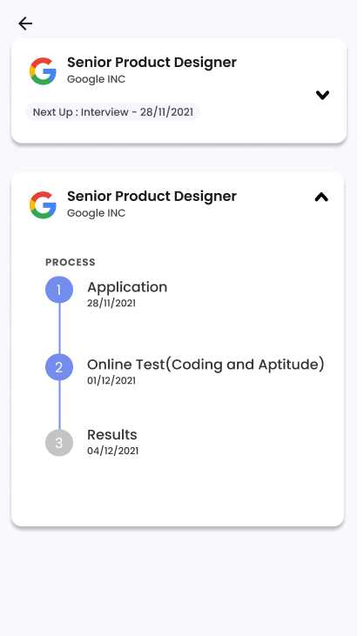
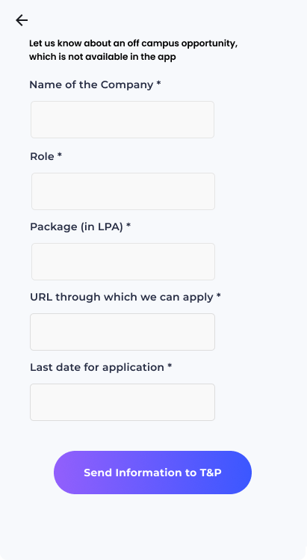
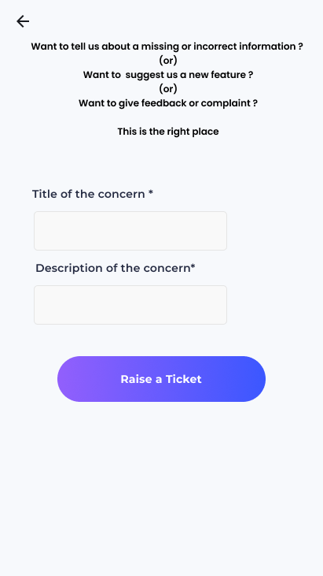

Slide 15
Conclusion
Placementor, both App and Website combinedly, would constructively help the college and students to have the process of placements being seamless and effective.

Slide 16
Future Scope
The solution can be made more automated and can include features like
Direct integration with companies
Prediction of future drives and tentative timelines
Providing a complete statistical view of placements to T&P department, Management and Public
The same solution can then be expanded to other colleges and institutions.

Slide 17
References
Flutter Documentation | flutter.dev/docs
Dart Documentation | dart.dev/guides
Package Repository for Dart and Flutter | pub.dev
Google Firebase Documentation | firebase.google.com/docs
Android & Android Studio Documentation | developer.android.com/docs

Slide 18
Thank you

